Slide 1
AutoML – Project 2019
Improving CNN performance on K49
Philipp Jankov

Slide 2
Motivation
New Task/Problem
Relying on known estimates for good values suboptimal
„Endless“ amount of configurations and algorithms
Large configspaces need more samples
No Free Lunch Theorem^{[1]}
„... for any algorithm, any elevated performance over one class of problems is offset by performance over another class…”
[1] No free lunch theorems for optimization, David H. Wolpert and William G. Macready, 1997

Slide 3
Approach
BOHB – ConfigSpace
Batchsize
Model
BaselineCNN
Resnet18
Warmstart (Resnet18 with 64x64 input only)
Model arguments
Dropout
zero_init_residuals (Resnet18 only)
Optimizers
Adam
AdamW (with Nestervo)
Optimizer arguments
Amsgrad
Nesterov (AdamW only)
Weight decay
Transforms
None
Predefined Pipeline
Random Rotation
Random Perspective
Random Elastic Transformation
Resize
Categorical, Bool, UniformFloat, UniformInt, Choices
Use BOHB with the rightside configuration space
Use refined gridsearch to determine initial LR
Select pretrained weights by distance in feature space (warmstart)
Let Baseline compete against un/-pretrained alternative

Slide 4
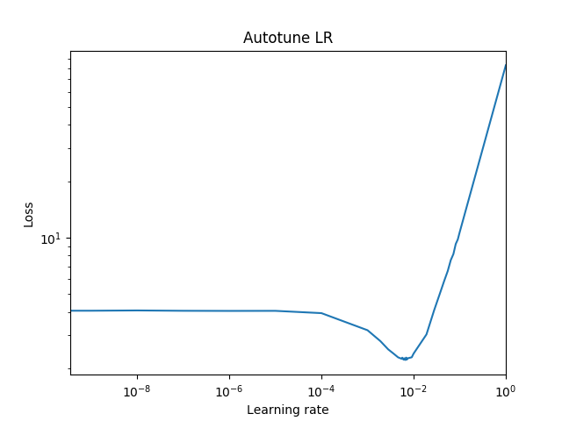
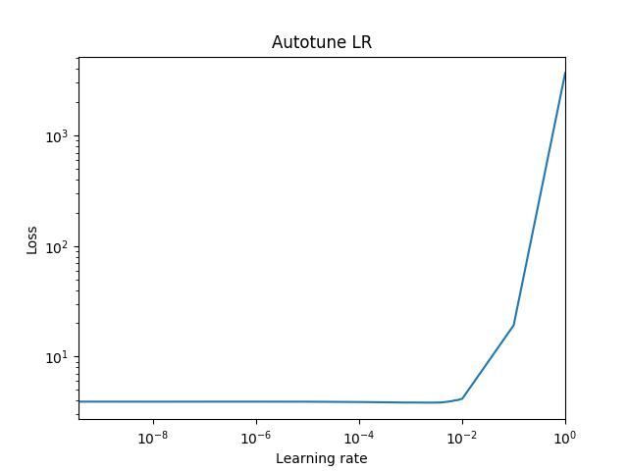
Autotune LR^{[1]}
Batchsize 238
Resnet
Dropout 0. 42
AdamW
WDecay 0.04
Validation acc
93.53
Refinement area
Remove LR from configspace
Refined Gridsearch to find initial LR
Determine magnitude
Refine around minimum
Complements adaptive Optimizer
Possible indicator for poor final performance
Batchsize 636
BaselineCNN
Dropout 0.53
AdamW
WDecay 0.14
Validation acc
52.81
Refinement area
[1] Cyclical Learning Rates for Training Neural Networks, Leslie N. Smith et al, 2017

Slide 5
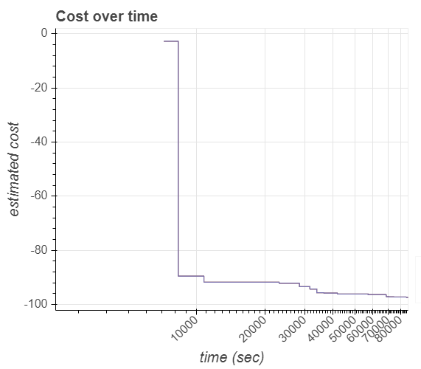
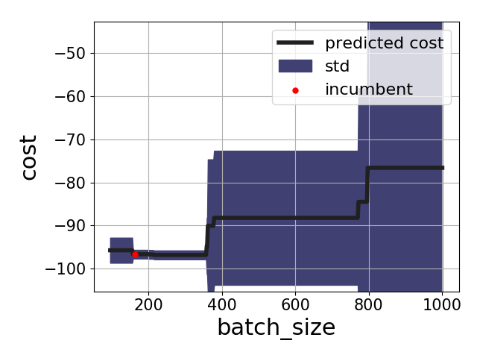
Results
Total time spent evaluating configurations | 85970.40 sec
Average time per configuration (mean / std) | 2046.91 sec (± 509.23)
# evaluated configurations | 42
Configuration origins | Acquisition Function : 27 Random : 15
fANOVA
 | Single importance | Final choice
optimizer | 70.9337 +/- 36.37 | AdamW
batch_size | 15.2346 +/- 25.9232 | 163
weight_decay | 1.1682 +/- 1.264 | 0.00122816
amsgrad | 0.846 +/- 2.8297 | False
zero_init_residual | 0.7148 +/- 2.7682 | True
transforms | 0.549 +/- 1.4886 | NONE
dropout | 0.3154 +/- 0.6798 | 0.755828
model | 0.1354 +/- 0.1334 | Resnet
5-fold Cross Validation
Dataset | BaselineCNN | Resnet
Validation | 78.2373±0.99 | 97.3933±0.206
Test | 66.1893 | 95.3434

Slide 6
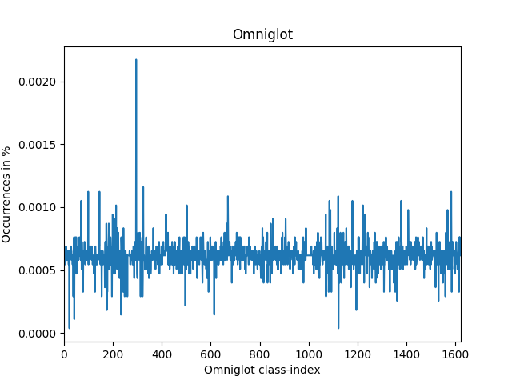
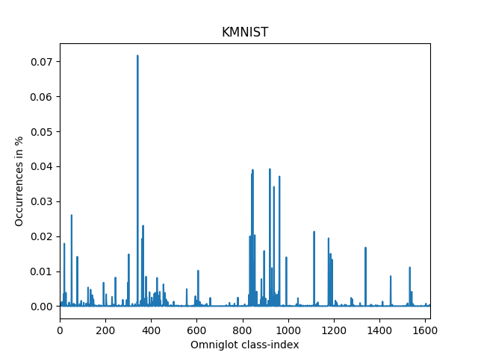
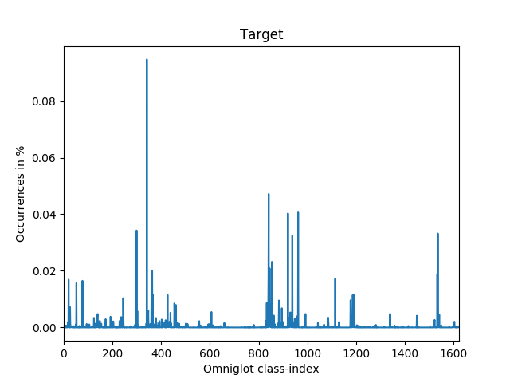
Discussion Warmstarting
Datasets in Omniglot Feature space
Test initial weights from portfolio
Use omniglot as feature space
Determine distance between supportsets and target
Select support set by smallest symetric diffrence in feature space
Select closest set and use it‘s pretrained weights
Known issues
Made the use of augmentation and warmstart codependent
Omniglot‘s pretrained weights were never chosen

